Slide 1
Object Oriented programming (basics of)
CT4027 – Tools Programming

Slide 2
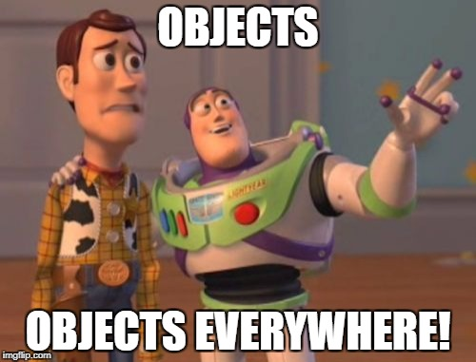
In this session…
Principles of Object Oriented Programming
Encapsulation
Inheritance
Polymorphism
Abstraction
C# Classes
Constructors
Public, Private, Protected, Internal
Inheritance
Function overriding
Static variables and functions
Interfaces and abstract classes
Abstraction

Slide 3
Principles of Object Orientation - Encapsulation
Encapsulation is the idea that a class should hide as much as possible of it’s inner workings from other classes
This is achieved by making a distinction between the internal workings of a class, and it’s public interface (i.e. methods or public properties)
In most object oriented languages, this distinction is enforced at a language level, by the use of certain keywords
Proper encapsulation ensures that as long as you know what the public interface of a class does, you don’t need to worry about how it works internally. This allows for changes in the internal workings of the class to be made, knowing that provided other code is using your public interface, you will not break it

Slide 4
Principles of Object Orientation - Inheritance
Inheritance is the concept that an object in an object oriented programming language is part of a hierarchy
For example, there are hundreds of different types of cars. However, each of them has characteristics of a “Car” concept, and each of them has characteristics peculiar to their particular manufacturer.
So the inheritance hierarchy for cars might look like so:

Slide 5
Principles of Object Orientation - Inheritance
Car
Nissan
Ford
…
Almera
Note
Focus
Fiesta
Ghia
…
…
So you can see, that:
Every Almera, is also a Nissan, and a Car.
Every Fiesta, is also a Ford, is also a Car.
And so on …
Everything a Car or a Ford can do, a Ghia can do. But a Ford cannot necessarily do everything a Ghia can do – because a Ghia may add extra functionality
A Fiesta and a Focus can do everything a car and Ford can do – but not necessarily exactly the same as each other

Slide 6
Principles of Object Orientation - Polymorphism
Polymorphism – but what does it mean?
So, when we talk about Polymorphism we mean having more than one form of something
In terms of C# programming we mean either:
Child classes (through inheritance) which have new versions of functions present in the base classes
Or, functions within the same class, which have the same name, but different parameters. C# will figure out what version of a function to call based on the supplied parameters

Slide 7
Principles of Object Orientation - Abstraction
Abstraction in programming terms means we can ignore irrelevant details
Example:
if an object is of class “Ford”, and of class “Car” because “Ford” inherits from “Car”
But we want to do something that all objects of type “Car” support, maybe “Brake”
We don’t need the extra features of an Ford or a Fiesta, to know that a car can brake – all cars can brake
In C#, we can refer to an object, using the type of it’s parent class, provided that we only want the functionality of that parent class

Slide 8
C# Classes
Great – so how does this all relate to C#?
You will have noticed that all the code we type lives inside a class in C#- this is because C# is a heavily object oriented language – everything is an object and there is no concept of a function that is not part of an object
When we define a class, what we are defining is a class of object, i.e. something that a C# object can be
We can then create instances of that object

Slide 9
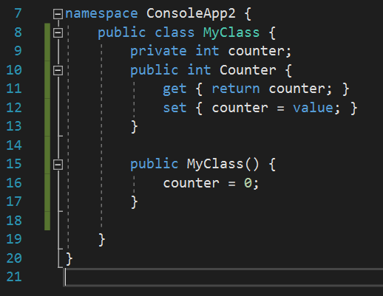
Creating a class - example
Here we create a class called MyClass
Which contains a private variable called “counter”
And a public property called “Counter” which gets and sets the value of “counter”
Bonus if you spotted that poor variable naming…
We also have a constructor…

Slide 10
Constructors
A constructor is a special function in our class
It is executed when an instance is created of that class
A constructor has:
The same name as the enclosing class
No return type (not even void)
Can take parameters
Constructors can be overloaded – which we will talk about later.
Constructors are usually used for initialisation and setup logic
You can use them for setting variable values, although you can leave that up to the classes user, by making variables accessible as properties which can be set using a class initialiser, or in C# by initialising them on creation at the class scope

Slide 11
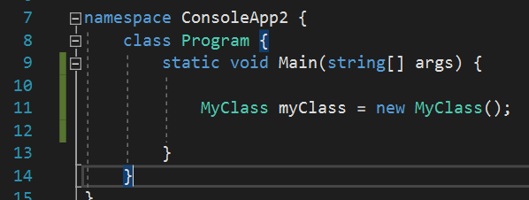
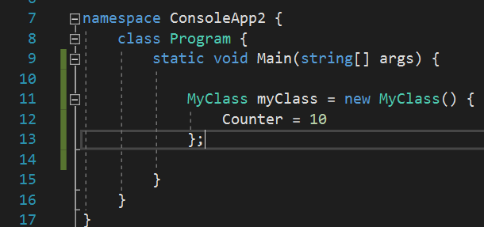
Instantiating our classes
Creating an object of the type of our class, is also known as instantiating, or creating an instance of, that class
This is most simply accomplished using the “new” keyword, as in the example on the right – if our constructor had parameters we would pass them in exactly the same way as when calling any function
We can also use a class initialiser, which creates a class and initialises property values in the same statement

Slide 12
Class Access Specifiers
You may have noticed that our custom class was specified as being “public” whilst the default “Program” class that contains our static main was unspecified
Classes in C# default to “internal” but can also be “public”

Slide 13

But, Will, What does that even mean?
A class which is specified as internal, can only be created from inside the same “assembly” i.e. .exe file, or .dll file
A class which is specified as public, can be created from any assembly that has access to that class. So if we create a class in a .dll library file, and it’s public, then when we load that .dll file into a .exe, we can create an instance of that class to use

Slide 14
Access Specifiers on class members
The astute will have noticed that the things we put inside the classes also have access specifiers, which can be:
public
private
protected
internal

Slide 15

Access specifiers - public
Public class members can be accessed from any location that can create a copy of that class
This rather breaks encapsulation, which is why we use Properties to maintain control over variable value changing, rather than making our variables public
Member functions can be public or private depending on whether they are required to use the class, or just helpful for the internal functioning of that class

Slide 16
Access Specifiers - private
Private is the default access level for a class property, field or method – if you don’t specify the access level, it will be private
This is because we mostly want class members to be private
Only specific members of the classes interface should be anything but private

Slide 17
Access Specifiers - protected
Protected class members are the same as private class members, for anything outside the inheritance hierarchy which is a concept we have talked in theory about, but will demonstrate practically later
Child classes can access these class members

Slide 18
Access Specifiers - internal
Internal class members are the same as private, for any code that is outside of the current assembly i.e. .exe or .dll file
For code inside of the current assembly, they are public

Slide 19
We’re over halfway – breathe!
Actual footage of me showing a new programmer object orientation

Slide 20
Inheritance Hierarchies
We have talked these through in theory
We indicate that a class inherits from another class, by putting a colon ‘:’ after its name, followed by the class name it inherits from
In C# each class can only inherit from one other class
When a child class inherits from a parent class, it can access all the public, protected and potentially the internal members of that class
It also has all the same variables and properties as that parent class
So it’s a way of saying “With this starting point [parent class] I am now adding this functionality to that, as a new type [child class]”.

Slide 21
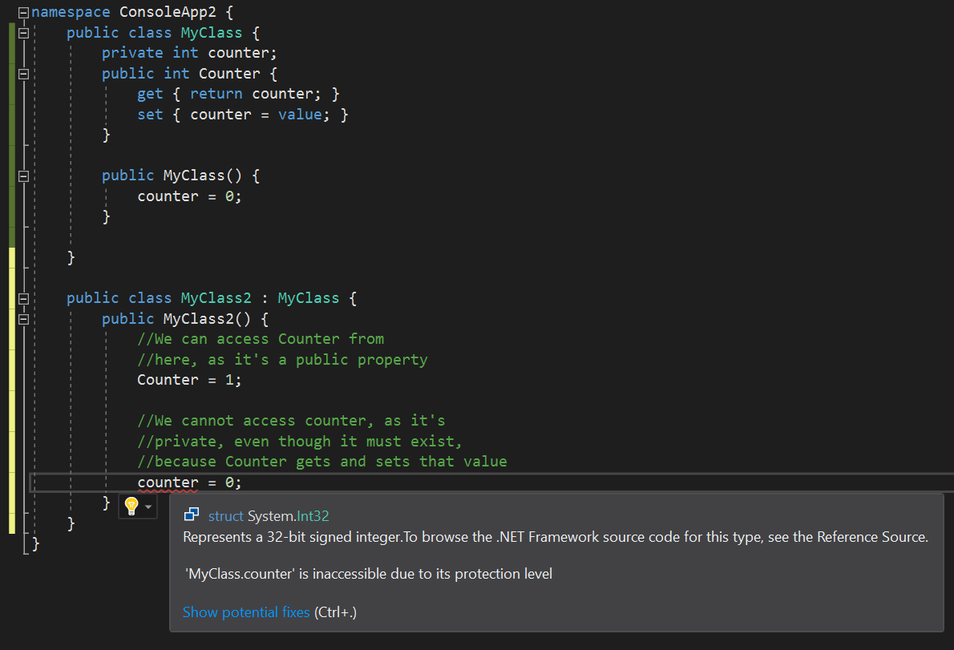
Inheritance Hierarchies - demo

Slide 22
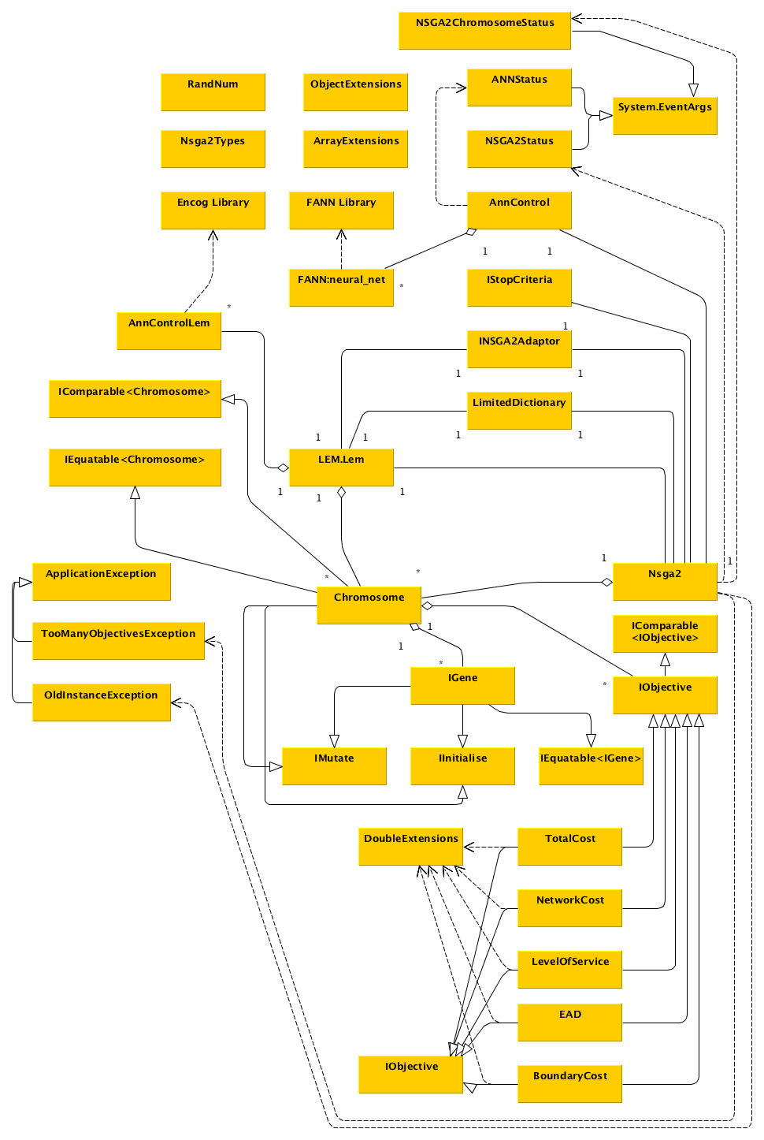
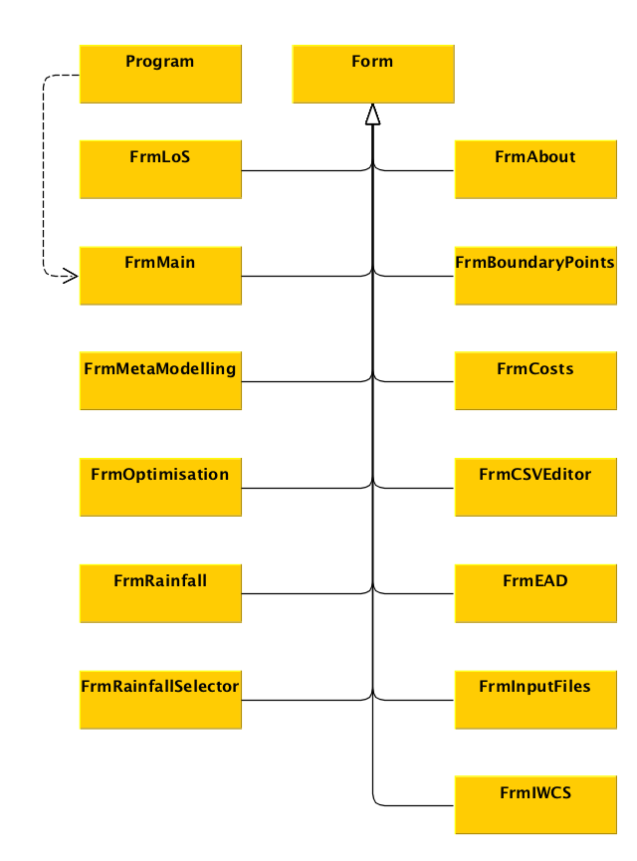
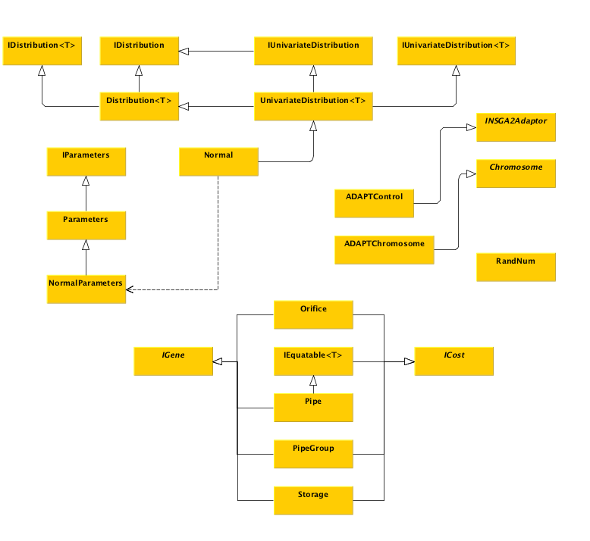
Class hierarchies can get fairly complex!
These are simplified diagrams of one program broken into three diagrams. This is a reasonably simple program!

Slide 23
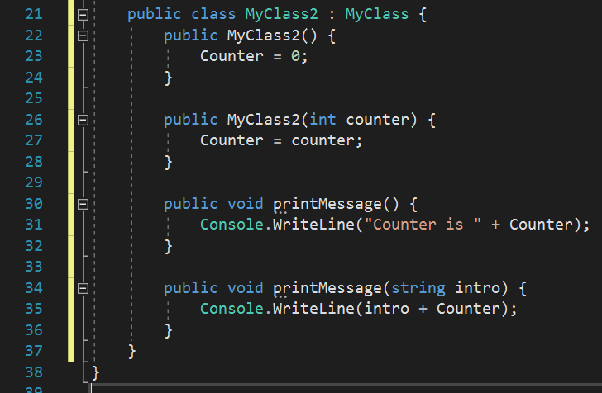
Function Overloading
We overload functions when we create a second function in the same class, with the same name, but with different parameters
C# will then figure out which function to call, by examining the parameters supplied along with the function call
The example on the right has an overloaded constructor, an overloaded printMessage function
We’ve talked about this before, but outside of the context of object orientation, now you know they work together!

Slide 24
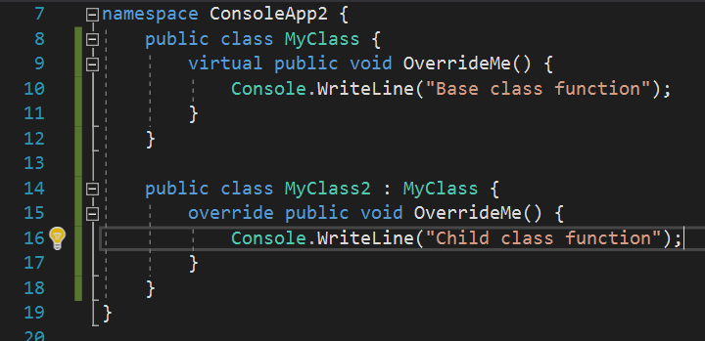
Function Overriding
We can also override a parent classes function inside a child class, provided the parent classes function is virtual, abstract, or an override itself
When we do this, we need to use the override keyword to let C# know that this is what we are doing, and we intend to be doing it
Overriding is different from simply having a function in each class, with the same name and parameters – particularly in terms of abstraction

Slide 25
Static variables and functions
A field (variable) declared with the keyword “static” exists in all instances of your class, with the same value, and is available even when the class hasn’t been instantiated
Similarly, a function declared with the keyword “static” is present in all instances of your class, and is available even when the class hasn’t been instantiated
Both of these are linked to the class TYPE as opposed to a specific instance of the class
This is why your main function is static – it needs to be accessible when the class may not have been instantiated
Static functions can only access static variables, and call other static functions, without a reference to a specific instance of their class
This makes sense – because they exist in all instances/as part of the type, they wouldn’t know which instance to call the function/access the variable on
You can call static functions by using the class type and a ‘.’ operator, or from any instance of your class
Even though we have been doing so a lot, for the sake of easy demo writing, we do not simply make everything static and simulate procedural (non-object-oriented) programming that way
Much like my poor variable naming in examples – it’s a case of do as I say, not as I do

Slide 26
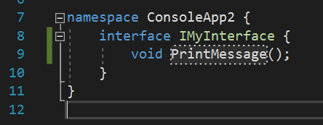
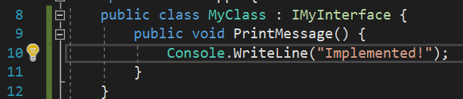
Interfaces
C# classes can only inherit from one other class
But they can implement an unlimited number of interfaces
An interface does not contain any logic or data, it merely outlines a number of functions that must be present and implemented in any class that inherits from that interface
You can use interface types for abstraction, provided you only need the functionality associated with that interface
By convention in C# all interface types start with a capitol ‘I’ and you should always stick to this – it makes it easy to know when you’re dealing with an interface

Slide 27
Abstract classes
Abstract classes are classes declared with the abstract keyword
They cannot be instantiated – you cannot create an instance of an abstract class
You can inherit from them
Abstract classes can contain abstract functions, which are created with the abstract keyword
Abstract functions contain no implementation, and must be overridden in child classes
So how do these differ from interfaces?
Abstract classes contain state information, unlike interfaces, and can have implementations to their methods
This means, they can still contain variables, normal functions, virtual functions, and potentially even override functions if you have a complex hierarchy (I don’t recommend this)
So you can implement some functionality, and require the rest to be implemented in a child class

Slide 28
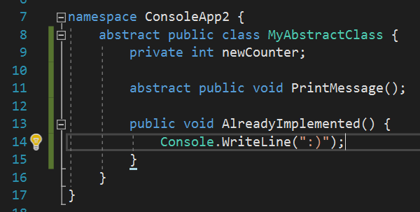
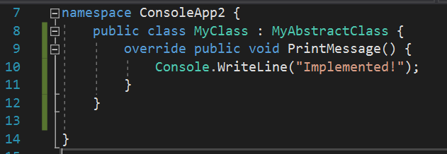
Abstract classes - example

Slide 29
Abstraction
When we have an instance of a class, we can refer to that instance using the type of any of it’s inheritance hierarchy.
For example if we have a system where every character and enemy inherits from “MobileUnit”
We could have an array of type “MobileUnit” and store all of our characters and enemys in there, regardless of their individual child class types
When we call a function on the items in this array, by default we will get the “MobileUnit” version of those functions
If we have overridden the functions, however, the appropriate child class function will be called, even though the type of the variable is “MobileUnit”
Just to note – if we have identical function names in a parent and child class but have NOT overridden, we do NOT get this behaviour. We simply get the MobileUnit version of that function, and when we use the child class type, we get that version of the function.

Slide 30
Any Questions?

Slide 31
Tutorial
There is a tutorial document available on moodle
Follow this through – we will be back onto Windows programs next week – for now, the key is that you get your head around object orientation without worrying about UI and the console is perfect for that

